Slide 1
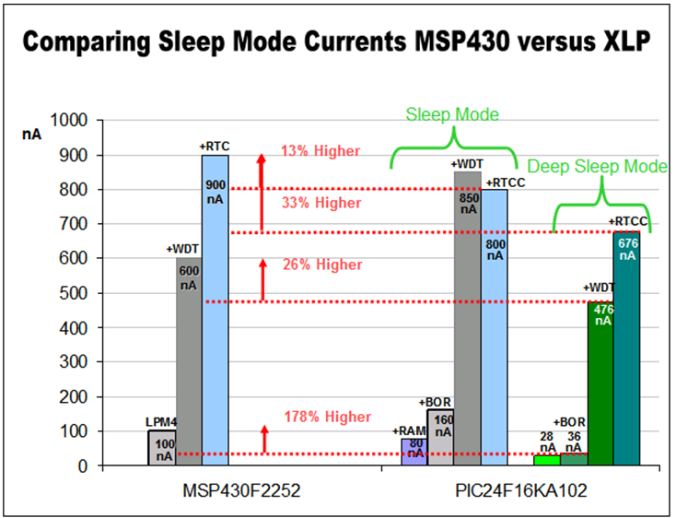
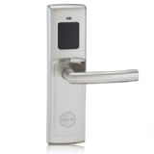
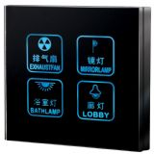
Topic1 -
Digital Lock
NXP Mifare Card Reader
Topic2 -
Battery-powered Application
PIC XLP to replace MSP430
Topic1 -
Digital Lock
NXP Mifare Card Reader
Part#:MFRC522 -> FM1702 PIC24F16KA102->MSP430F2252
MCU: PIC XLP & NXP Cortex-M0

